Slide 1

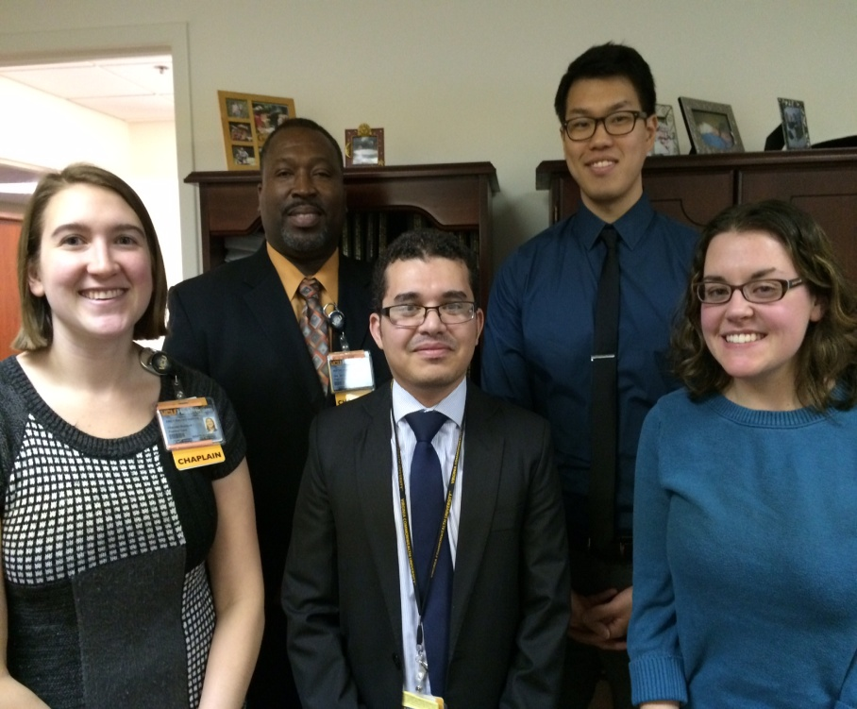
INTERPROFESSIONAL COLLABORATION (IPC) AND HORIZONTAL INTEGRATION:
A STUDENT PROJECT EXAMINING STAFF PERCEPTIONS OF COLLABORATIVE PROCESSES
IN VCU HEALTH UNITS
Angie Flack, M. Div., M.S., Director of Education and CPE Supervisor,
Diane Dodd-McCue, D.B.A., Associate Professor
VCU Department of Patient Counseling
INTRODUCTION
Patient-centered care addresses mind, body, and spirit. Clinical chaplains are specifically trained professionals who provide spiritual care in health services environments. VCU Health chaplains provide spiritual care to patients, families, and staff 24/7. VCU Department of Patient Counseling trains future clinical chaplains through its Clinical Chaplaincy Education (CPE) and MS Program. The MS Program includes mandatory research training in an evidence-based care environment.
SIGNIFICANCE
Understanding chaplain integration into unit care teams promotes improved efficiency and effectiveness. Shared dimensions to describe integration promote smooth transitions between clinical professionals. This project contributes to improved interdisciplinary performance, improved patient centered, and improved efficiencies. This project was initiated for quality improvement based on evidence gained using research methods. Classroom coverage focused on research literacy. Chaplain students also completed Collaborative Institutional Training Initiative (CITI) required for human subjects research and REDcap tutorals as prerequisites for this project.
AN IPC-CENTERED CONCEPTUAL FRAMEWORK
Interprofessional collaboration (IPC) relies on role integration. As an organizational concept, integration is the extext to which specialized roles are understood and incorporated into coordinated team activities and performance. Within the context of health services delivery, Bronstein (2002) suggests that IPC includes five components: interdependence; newly created professional activities; flexibility; collective ownership of goals; and reflection on process. The Index of Interdisciplinary Collaboration (IIC-42) (Bronstein, 2002, 2003) is composed of five subscales that measure each of these components on a 4-point scale ranging from strongly agree to strongly disagree. ICC-42 subscales and of corresponding questions appear below.
Interdependence
I utilize other professionals for their particular expertise.
Newly Created Professional Activities
Distinct new programs emerge from the collective work of colleagues from different disciplines.
Flexibility
I am willing to take on jobs outside of my job description when they seem important.
Collective Ownership of Goals
Professions from other disciplines with whom I work encourage patients' and family members' participation in the care process.
Reflection on Process
I discuss with professionals from other disciplines the degree to which each of us should be involved in a particular case.
RESEARCH METHODS
Chaplain students in Spring 2016 PATC 642 (above right) are implementing this project in their assigned VCU Health units based on a preliminary data collection plan developed with their service line liaisons. This plan emphasizes the support of unit supervisors. The project uses a non-experimental design and convenience sampling. The unit of analysis is the VCU Health unit in which chaplain students are assigned. The Index of Interdisciplinary Collaboration (IIC-42), developed by Bronstein (2002, 2003), is being used to capture staff perceptions. This instrument is available electronically through REDcap and in paper form. upon request. Responses are confidential and only aggregate results will be used.
HOW DOES THIS PROJECT CONTRIBUTE TO CHAPLAINCY?
The findings have value to chaplains as well as to other members of the interdisciplinary care team. The findings provide a profile of chaplain integration in VCU Health units. The findings may suggest opportunities for strengthening integration by interdisciplinary care teams to promote the delivery of evidence-based patient care.
This project also demonstrates the students’ application and mastery of research methods that can contribute to process analysis and quality improvement. Hands-on experiences highlight the challenges of study recruitment, survey research, response biases, and dissemination of results. The research skills used here may be helpful in future ministries- in and out of hospital chaplaincy- as well as in fulfillment of professional board certification requirements.
EXAMPLE OF DISPLAY OF SURVEY RESULTS
The IIC-42 is being completed by staff from six VCU Health units. A demographic profile of respondents from each unit will be developed based on gender, professional category, hours and shift worked, age, years in profession, and tenure in health system. This profile will demonstrate the degree of representativeness and generalizability of results to the unit of interest.
As a project aimed at quality improvement, actual unit results are confidential and only available to relevant stakeholders who will be provided these results for quality improvement. Provided here are examples to demonstrate how the results will be displayed to relevant stakeholders. Dissemination of results is a critical component of the project. Chaplain students will tailor this to meet the needs of each unit; deliverables will include presentations, posters, and executive summaries.
Survey results will be used to develop a unit-specific profile of integration and collaboration based on the five interdisciplinary components identified by the IIC-42. The display to right shows how a profile of integration will be displayed. This example reflects a unit that is invested in collective ownership of unit goals and values reflection. Although the results for other integration dimensions are relatively lower, this suggests future potential opportunities for integration of disciplines with the care team.

